Slide 1
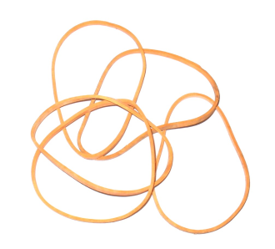
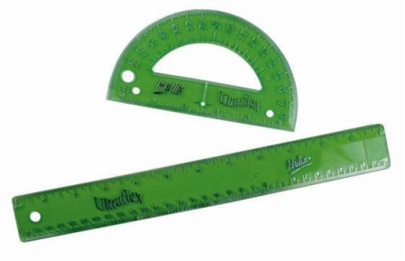
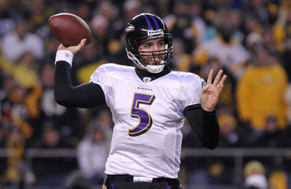
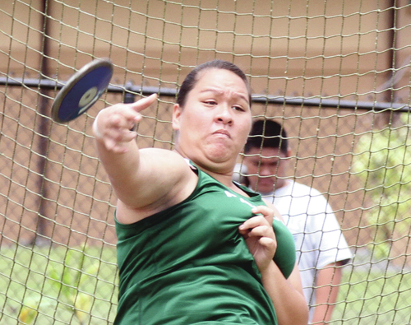
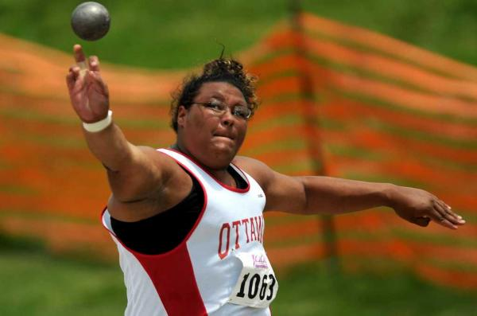
“The Best Throw”
(Grades 4-8)
Allison Hasse

Slide 2
Goals and Objectives
Goal: Students will be able make predictions and test hypotheses with experimental results.
Objectives: Given a protractor, ruler, rubber bands, and measuring tape, students will be able to:
Make predictions;
Create a chart for the collection of experimental results;
Graphically analyze the relationship between variables in an investigation.

Slide 3
Explanation/Introduction
If you want to throw a baseball or softball as far as you can, at what angle should you throw it?
If you throw it too low, it will fall to the ground too quickly.
If you throw too high, it won’t fall very far away from you.
The best angle is somewhere in between.
WHAT DO YOU THINK THE BEST ANGLE WOULD BE?
Make a prediction:____________________

Slide 4
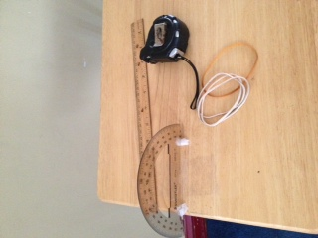
Materials Set Up
Protractor
Ruler
Rubber bands
Measuring Tape
Calculator
Writing utensils
Worksheet
Works best with students working in teams of 2 or 3, in a large room with a high ceiling
Do a test to determine how far back the rubber bands should be pulled so that they do not fly too far.
Make sure the ruler is held at straight and at the appropriate angle.
Determine the proper length of pull so that the rubber band travels about 5-10 feet.

Slide 5
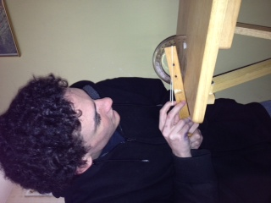
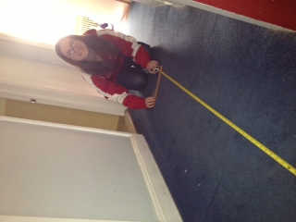
Procedure Let’s do an experiment to find the best angle
1.) Stretch a rubber band from the end of a ruler to one of the marks on the ruler (6 inches for this experiment).
2.) Set the ruler at an angle 15° off the surface, pointing the end with the rubber band into the air.
3.) Let the rubber band go and have a partner measure how far it travels with the measuring tape.

Slide 6
Make a table
4.) Do steps 1 – 3 for at least 10 more angles in the range of 15° to 90° Record the data in a chart.
Degrees | Distance (In Feet)
15° | 5 $\frac{101}{120}$ ft.
25° | 6 $\frac{23}{24}$ ft.
35° | 9 $\frac{1}{12}$ ft.
45° | 9 $\frac{25}{48}$ ft.
50° | 8 $\frac{15}{16}$ ft.
55° | 7 $\frac{19}{48}$ ft.
65° | 7 $\frac{1}{3}$ ft.
75° | 4 $\frac{5}{8}$ ft.
85° | 2 $\frac{17}{20}$ ft.

Slide 7
Graph it!
5.) Make a graph showing your data.

Slide 8
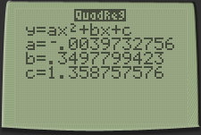
Thinking Further…
7.) Using your calculator, find the equation for our set of data.
STAT, Edit, #1: Enter data into L1 & L2 (Degrees into L1, and Distance into L2).
2nd STAT PLOT, Turn on Plot 1. Select the scatter plot option.
Zoom #9 to view the scatter plot.
STAT→CALC→#5: “QuadReg”→Enter.
Use your “a,b,c” values to write the equation of the parabola in form. Round to the nearest thousandth: $−.004x^{2}+.350x+1.359$
Plug this equation into your “Y=” and press Zoom #9 in order to see how the equation fits the data collected in this investigation.

Slide 9
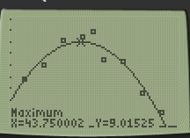
Thinking Further…
8.) Find the maximum value on the parabola. Is it close to our prediction?
2nd→CALC→#4: maximum
Maximum Value ≈ 43.75
9.)Calculate the percent error.
% error=|(Experimental Value − Exact Value)|×100 Exact Value
% error = |(45− 43.75)| x 100
45
% error ≈ 2.78%

Slide 10
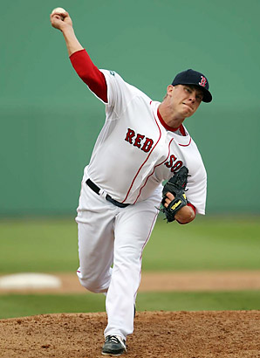
Connections & Extensions
Andrew Bailey throws a fastball at a 37° angle. About how far will the baseball travel in feet? Is it likely that the player at bat will hit the ball? Why or why not?
a) Make a prediction.
b) Based on the results from our experiment, find the approximate distance.

Slide 11
Connections & Extensions
2. A triangle has two angles of 50° and one angle of 80°. Using a protractor and a straight edge, draw and determine what type of triangle you have. (7.G.2)

Slide 12
References
The Futures Channel. (2000). The best throw: Teaching guidelines. Retrieved from http://www.thefutureschannel.com/pdf /math/the_best_throw.pdf

